Slide 1

Rockbuster Stealth LLC
Data Dictionary

Slide 2
Table Of Contents

Slide 3
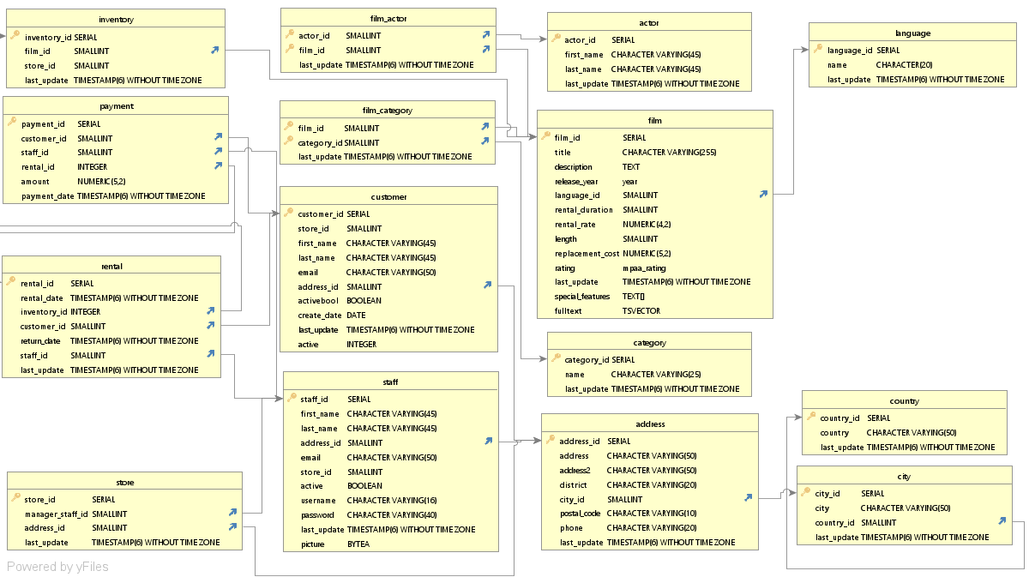
Entity Relational Diagram

Slide 4
Fact Table
Rental
Column | Data Type | Description | Key
rental_id | SERIAL | # assigned to rental | Primary
rental_date | TIMESTAMP(6) WITHOUT TIME ZONE | Date of rental
inventory_id | INTEGER | # assigned to item | Foreign
customer_id | SMALLINT | # assigned to customer | Foreign
return_date | TIMESTAMP(6) WITHOUT TIME ZONE | Date of return
staff_id | SMALLINT | # assigned to employee | Foreign
last_update | TIMESTAMP(6) WITHOUT TIME ZONE | Date of update

Slide 5
Dimension Tables:
Payment
Column | Data Type | Description | Key
payment_id | SERIAL | # assigned to payment | Primary
customer_id | SMALLINT | # assigned to customer | Foreign
staff_id | SMALLINT | # assigned to employee | Foreign
rental_id | INTEGER | # assigned to rental | Foreign
amount | NUMERIC (5,2) | Payment amount
payment_date | TIMESTAMP(6) WITHOUT TIME ZONE | Date of Payment

